Slide 1

Product Reliability and Quality
MSET 5130
Topic : Process and Product Quality Assurance
Group 7
Koppula Ruchitha Elena,
Mani Surya Kotti,
Kommula Manish Teja Reddy
Date: 04/19/2023

Slide 2

ABSTRACT
In engineering design and manufacturing, process and product quality assurance play crucial roles in ensuring the quality and reliability of products. Process quality assurance involves establishing consistent, efficient, and effective procedures to manage critical control points within an organization's processes. This can be achieved by implementing quality management systems, establishing process metrics, and conducting regular audits. On the other hand, product quality assurance involves ensuring that the products meet or exceed customer expectations while complying with relevant regulations and standards. This requires implementing design and testing processes, conducting product testing, establishing quality control measures, and ensuring compliance. Understanding these two essential aspects is critical to ensuring the success of any engineering design and manufacturing project. In this presentation, we will discuss process and product quality assurance, their importance, and how to implement them effectively in engineering design and manufacturing.

Slide 3

Overview of the importance of Process and Product Quality Assurance
Process and Product Quality Assurance are essential to ensuring product reliability and quality.
These approaches involve implementing systems and procedures to control and monitor the product development and manufacturing processes.
By ensuring that products meet established quality standards and customer requirements, companies can build trust and loyalty with their customers.
Failure to implement Process and Product Quality Assurance can lead to product defects, recalls, and damage to a company's reputation.
Therefore, understanding and implementing Process and Product Quality Assurance is critical for companies to compete in the marketplace and meet customer demands.

Slide 4
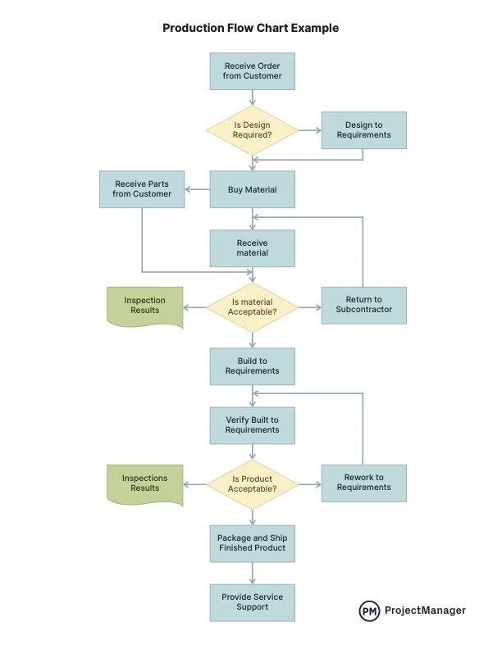
Process Quality Assurance
Definition: A systematic approach to ensuring that processes are designed, documented, and executed to meet the requirements of stakeholders, with the goal of producing consistent and high-quality products.
Importance: Helps to reduce errors and waste, improves efficiency, and increases customer satisfaction.

Slide 5
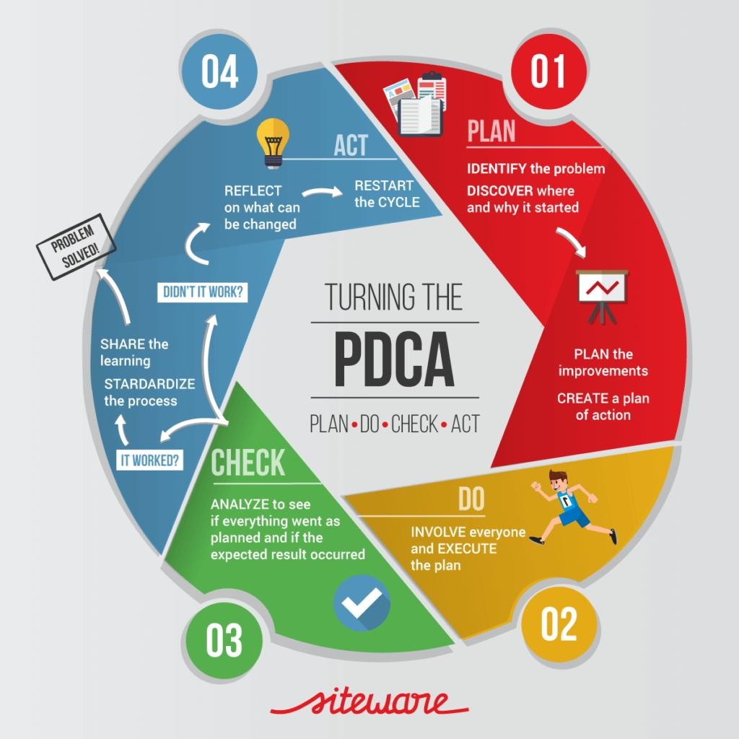
Key Components of Process Quality Assurance
Process documentation: Standard operating procedures, work instructions, process maps, etc.
Process control: Monitoring and controlling process variables to ensure consistency and quality.
Process measurement and analysis: Collecting and analyzing data to identify trends and opportunities for improvement.
Process improvement: Continuously improving processes to reduce defects, waste, and costs.

Slide 6

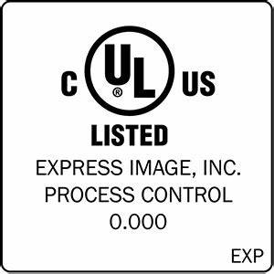
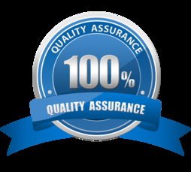
Product Quality Assurance
Definition: A systematic approach to ensuring that products meet customer requirements and expectations, with the goal of producing high-quality and reliable products.
Importance: Helps to reduce defects and recalls, improves customer satisfaction, and protects the company's reputation.

Slide 7
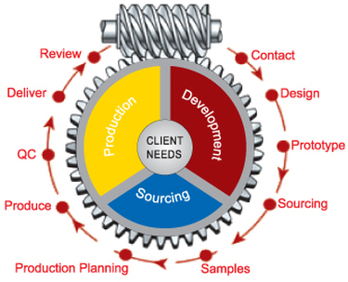
Key Components of Product Quality Assurance
Design and development: Ensuring that products are designed to meet customer needs and requirements, and that potential failure modes are identified and addressed.
Manufacturing and production: Ensuring that products are manufactured consistently and to the required specifications, with appropriate testing and inspection.
Inspection and testing: Performing inspections and tests to verify that products meet quality requirements.
Customer feedback and complaints: Collecting and analyzing customer feedback and complaints to identify areas for improvement and prevent future problems.

Slide 8
Quality Control vs. Quality Assurance
Quality Control: A reactive approach to ensuring quality, focused on detecting and correcting defects before products are shipped to customers.
Quality Assurance: A proactive approach to ensuring quality, focused on preventing defects and ensuring that processes and products meet customer requirements.
Quality Assurance | Quality Control
A managing tool | A corrective tool
Process-oriented | Product-oriented
Proactive strategy | Reactive strategy
Prevention of defects | Detection of defects
Everyone’s responsibility | Testing team’s responsibility
Performed in parallel with a project | Performed after the final product is ready

Slide 9
Tools and Techniques for Process and Product Quality Assurance
Statistical Process Control (SPC): Using statistical methods to monitor and control process variables.
Failure Mode and Effects Analysis (FMEA): Identifying potential failure modes and their effects, and taking action to prevent or mitigate them.
Six Sigma: A data-driven approach to reducing defects and improving quality.
Lean Manufacturing: A system for reducing waste and increasing efficiency.
Total Quality Management (TQM): A holistic approach to quality that involves all employees and focuses on continuous improvement.

Slide 10
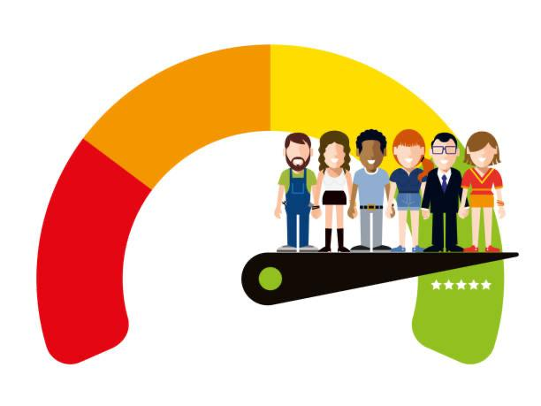

Best Practices for Process and Product Quality Assurance
Standardization and Documentation: Used to maintain consistency and improve quality
Employee training and development: Used to improve skills and knowledge
Continuous improvement and innovation: Used to stay ahead of the competition
Data-driven decision making: Used to make informed decisions and improve processes
Customer focus and satisfaction: Used to improve product quality and loyalty

Slide 11
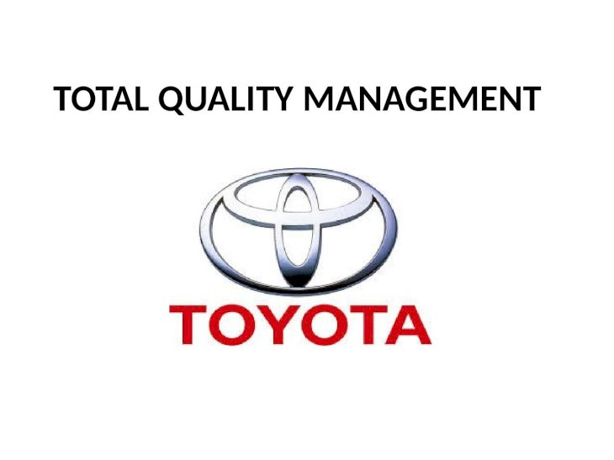


Some Examples of Case Studies:
Toyota: Uses Lean Manufacturing and Total Quality Management to improve efficiency and quality.
Motorola: Uses Six Sigma to reduce defects and improve quality.
General Electric: Uses Statistical Process Control and Failure Mode and Effects Analysis to improve quality and reliability.

Slide 12

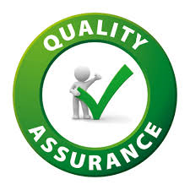
Conclusion
To summarize, Process Quality Assurance focuses on improving the procedures used for creating a product or service, whereas Product Quality Assurance focuses on examining and confirming the final outcome of a good or service's quality. Both types of quality assurance are critical in ensuring that the finished good or service satisfies the established quality standards and meets the requirements and expectations of the consumer. Organizations may boost their overall efficiency, cut expenditures, and improve client satisfaction by employing strong quality assurance methods.

Slide 13
Thank You.
Any Questions?
Email:
Ruchithaelenakoppula@my.unt.edu
manishtejareddykommula@my.unt.edu
manisuryakotti@my.unt.edu
Group 7

Slide 14
Bibliography
"Quality Assurance: Applying Methodologies for Launching New Products, Services, and Customer Satisfaction" by Eric S. Rebentisch. This book provides an overview of quality assurance methods and tools for achieving customer satisfaction in new product development and service delivery.
"Product and Process Design Principles: Synthesis, Analysis, and Evaluation" by Warren D. Seider, J. D. Seader, and Daniel R. Lewin. This book covers design principles for product and process development, including design for quality and reliability.
"Quality Management for Organizations Using Lean Six Sigma Techniques" by Erick C. Jones. This book provides a comprehensive guide to quality management using Lean Six Sigma techniques, including process and product quality assurance.
{ Rebentisch, E. S. (2017). Quality Assurance: Applying Methodologies for Launching New Products, Services, and Customer Satisfaction. John Wiley & Sons.}
{ Seider, W. D., Seader, J. D., & Lewin, D. R. (2017). Product and Process Design Principles: Synthesis, Analysis, and Evaluation. John Wiley & Sons.}
{ Jones, E. C. (2016). Quality Management for Organizations Using Lean Six Sigma Techniques. CRC Press.}

